Slide 1
Introduction to Family Medicine
General Practice Experience
Session 1 Introduction
2024/25

Slide 2
General Practice Experience
Care within the practice and within communities
Aims of the module
Look at what happens “day to day” in Primary Care
Show how the patient needs identified in Family Attachment are met in Primary Care​
Look at the pivotal role Primary Care plays in patients’ lives​
Introduce the wider Primary Care team​

Slide 3
Session 1 (Today!)
Structure of course (and plan for further sessions)
Presentation
“The Essence of General Practice”
Interactive patient discussion on “the work of being a patient”
Objectives
To understand General Practice and how it meets patient’s needs
To outline what distinguishes General Practice and Primary Care from hospital medicine and Secondary Care
To develop a person-centred mindset by considering the “work of being a patient”
To understand how General Practice has developed in UK

Slide 4
Sessions 2-4
Practice based sessions
Aim is to give a rich General Practice experience, based on practitioner’s and patient’s experience
Observing and taking part in patient consultations
Observing members of the Multi-disciplinary team

Slide 5
Sessions 5
Assessment session
Assessed on
Engagement/Participation of the student
Presentation
“Using your experience in General Practice (both with patients and staff), how has General Practice evolved to provide person-centred care, population centred care and efficient delivery of care in community settings? Illustrate with examples from your time in General Practice Experience”.

Slide 6
Introduction to Family Medicine
“The Essence of General Practice”

Slide 7
Characteristics of General Practice
Holistic care of the whole patient (not based on a system for example)
90% of patient presentations happen solely in GP (with less than 10% of the funding)
Undifferentiated illness
“Cradle to grave”
Problem based approach
The patient, in the first instance decides when to consult the GP

Slide 8
Brief history of General Practice in the UK
Community-based medicine was carried out by apothecaries, passing knowledge through apprenticeships
The diagnostic model of clinical reasoning came about in the 19th century
The National Health Service rolled out in 1948, of which General Practice was key
“The arrangements for general medical practice are the most important part of the proposals for a National Health Service”.
The Medical Act 1958 brought regulation for all doctors e.g., assessments to be passed and regulation by the GMC
Notes:
The diagnostic model came about with new technological advances such as the stethoscope, microscopy. This facilitated the connection between medical symptoms and pathological causes of disease resulting in the development of a clinical method – eliciting symptoms, examining, testing specimens and diagnosis/treatment.

Slide 9
“Health systems like the NHS, which feature strong primary care with GP-registered lists and a gatekeeper function, generally have better health outcomes at lower cost. Evidence suggests that GPs contribute to this by requesting fewer tests and procedures and, where there is continuity with a lead GP, they refer to hospitals less. These approaches are characteristic of the medical generalist role.”
From Rebecca Rosen’s 2018 report “Divided we fall: getting the best out of general practice”

Slide 10
Structure of General Practice in the UK
First point of contact with the NHS
Practices are independent
  “Owned” by a group of GPs either in private premises or Health Centres
  Small businesses
  Able to act as patients’ advocate
GPs work in different settings e.g., patients’ home, Nursing Homes, walk-in centres, EDs. Access v continuity
Funding comes through the Global Sum which can be enhanced by for example through Enhanced Services
Notes:
As per the five year deal, global sum will increase by 3% from £96.78 to £99.70 per weighted patients.
From https://www.bma.org.uk/pay-and-contracts/contracts/gp-contract/gp-contract-changes-england-202223
Average number of patients per full time GP 2500

Slide 11
General Practice in other countries
The term ‘General Practice” is not widely used elsewhere; alternatives include Primary Care (wider team including doctors) or Family Medicine/Practice (doctors)
In other countries, this can be funded by the state, by insurance schemes, be fully private or have little coordinated care. Often there is a mix
Example : Cuba – universal high-quality primary care coverage – one of the highest life expectancies
Example : USA – mostly private Family Medicine, few home visits. Expensive provision with worse health outcomes
Any student from outside the UK/Ireland can explain ‘General Practice” in their country to the group

Slide 12
Who is my patient?
Everybody on the practice “list”
Temporary residents and Immediately Necessary Treatment
In hours v Out of Hours
GP and A&E – the only places patients can ‘turn up’ to be seen

Slide 13
Pressures on GP
An ageing population
  Multi-morbidity in aging population
  More complexity
  Polypharmacy
Societal changes
  Increasing patient expectation
  More multi-cultural society
  More democratisation of medical knowledge e.g., ‘Dr Google’

Slide 14
Pressures on GP
Changing work and workforce
  Less GPs per head of population
  “Transforming your Care” – drive to move care from hospitals into the community
  Funding issues
  Emerging from the pandemic

Slide 15
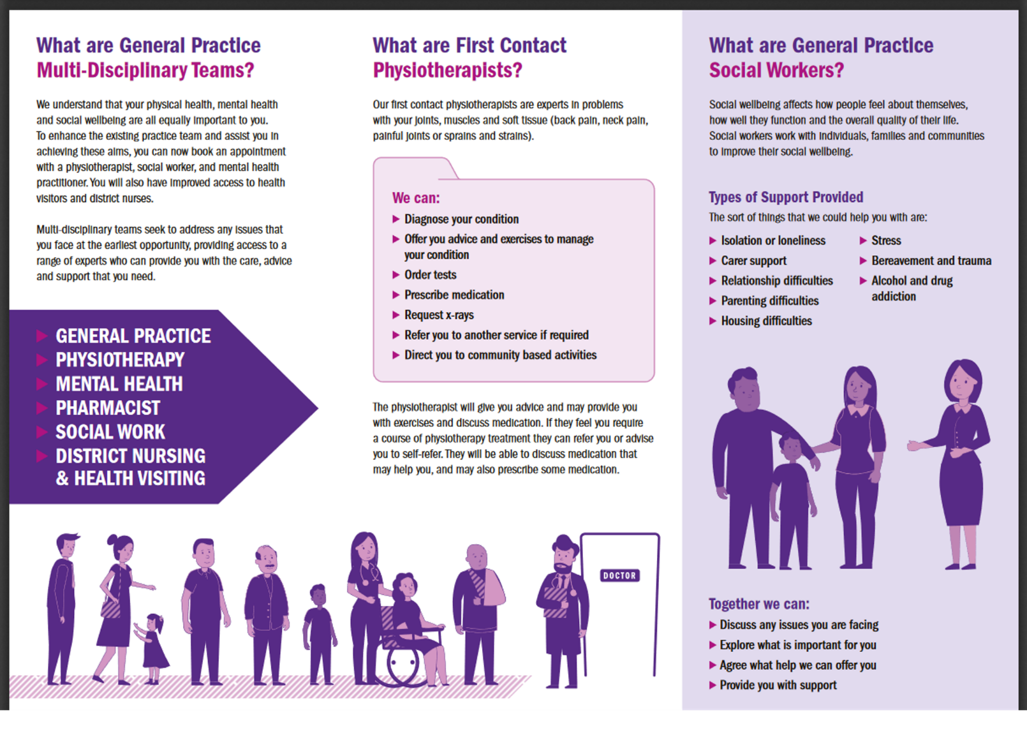
Attempts to address pressures
GPs have lobbied for resources
Emergence of GP Networks, called Federations in Northern Ireland
MDTs (who? roles? availability?)
Notes:
Politics in medicine!!

Slide 16
Attempts to address pressures
Increasing use of Information Technology
- Remote consultations, Accurx etc. but who is at a disadvantage with IT?

Slide 17
High Points
Opportunity to
  Organise practice as you see fit
  Develop responsive services for your patients
  Provide truly whole person care
Seeing that you can really make a difference in people’s lives daily
Acting as an advocate for patients
Working in a team with colleagues
Flexible working/portfolio careers

Slide 18
What is special about the specialty of General Practice?
Getting to know patient/family over a lifetime
Developing a sense of perspective, what is important to individual patients
Making sense of undifferentiated illness
Managing complex chronic disease and multi-morbidity
Individualising care for the ‘whole patient’
Anticipatory care
Our expertise lies in people

Slide 19
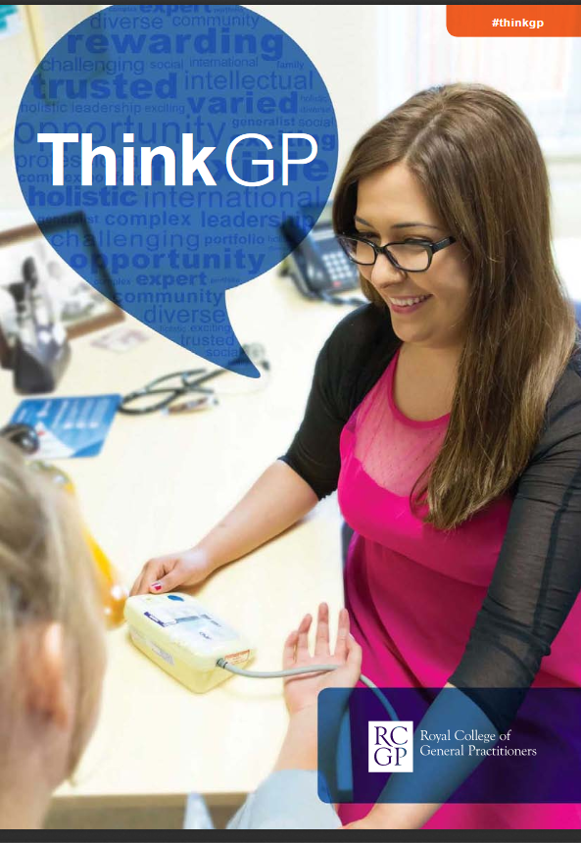
My route into General Practice
Notes:
https://www.cogped.org.uk/images/docs/meeting-docs/demec/RCGP_-_Think_GP.pdf

Slide 20
Introduction to Family Medicine
“The work of being a patient”
Developing a person-centred mindset

Slide 21
Starting point
To develop a person-centred mindset, consider how patients manage their health outside their brief encounters with health professionals, their “work of being a patient”
Consider the challenges patients may face in this work
Aligns with the Cultural Humility ethos of “becoming the student of the patient”

Slide 22
Part 1 – What “work” does a patient have to do to manage their health?
As a group, detail and present in a timeline what a patient actually does when they feel they need to see a GP.
Notes:
Interactive activity – give the student group a few minutes to discuss and put into a timeline what they think a patient ‘does’ when they decide they need to see a GP. They might need some help getting started and jump to ‘phone the practice’, try to bring them back even to the point where they decide to seek help. Ask one of them to present this to you. They as health literate, IT savvy young people may see little problems with this
The idea is to help the students consider, using just this example of something simple and seemingly routine like booking an appointment, some of the work that a patient does to manage their health and illness and to negotiate having their needs met in Primary Care.

Slide 23
Part 1 – What “work” does a patient have to do to manage their health?
What factors might make this challenging?
Notes:
Then offer challenge to this, suggestions include
How do you decide you need to see a doctor? Who decides?
What if you don’t have a phone
What if you can't get through to the practice or you’ve missed phone-in time?
What is your phone is out of charge/credit?
What if you have difficulty hearing the receptionist?
What if it’s the third day you have rang the practice this week?
How do you get there? What if you have no transport or money for public transport?
What if your mental health is worse first thing in the morning and this is when your appointment is?
What if you are a carer?
What if you are agoraphobic?
How will you describe how you feel to the time pressured doctor?
And this is before a patient even makes it into a consulting room.
The idea is to help the students consider, using just this example of something simple and seemingly routine like booking an appointment, some of the work that a patient does to manage their health and illness and to negotiate having their needs met in Primary Care.

Slide 24
Part 1 – What “work” does a patient have to do to manage their health?
Research has given some examples of “work” that might not occur to health professionals
Patient’s internal negotiation when deciding to seek help
The work of booking an appointment,
The work of waiting in a waiting room,
The work of appearing as a “good” patient
Notes:
This research was carried out by a Nurse Rachel Webster in New Zealand
Ask for the student’s reflections on this – in a group of students with varied life experience and including some graduate students who may work as health professionals themselves, their thoughts will differ but hopefully it opens up a discussion.

Slide 25
Part 2 – Hearing directly from a patient describing their “work”
Notes:
Obviously, you will want the patient to lead this discussion but what you really want them to concentrate on is how they manage living with their illness. I suggest starting with asking then a little about how and when they were diagnosed, just for context. Then ask about a typical day for them – what you really want is how they live with their illness as opposed to clinical details that students can get from a textbook. This may need teased out a little as likely the patients are also probably not used to discussing this ‘hidden work’ in detail or having anyone listen to them about it for any length of time! For example, if they say “I check my blood sugars twice a day” ask then to describe step by step what this actually means – when do they do it, where, how they do it, how does it feel and what they do with the result. Could they demonstrate it for the students? What you want is the behind the scenes information that doesn’t get written down anywhere and that students won’t learn about or appreciate otherwise.
This is probably the point you will want to stop the presentation

Slide 26
Introduction to Family Medicine
General Practice Experience
Session 1 Introduction

